Slide 1

Ludlow-Taylor Elementary School January LSAT 2026 Meeting
1.20.26

Slide 2
Agenda
Prior LSAT Meetings Updates
Enrollment projections
SLP services
Staffing vacancies/changes
Addition opening/timeline
Community Survey re: Budget Priorities
Any Other Business / Questions from Non-LSAT Members

Slide 3

L-T Enrollment projections

Slide 4
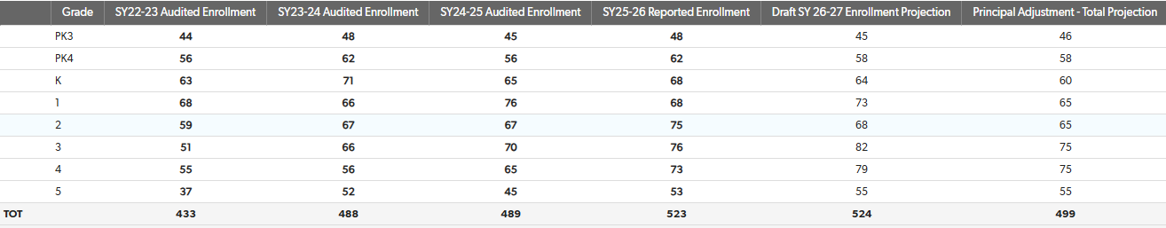
L-T Enrollment projections: Background
Enrollment projections for each school are the chief inputs that DCPS uses to calculate individual school budgets (i.e., schools get $ per student and/or per class).
However, historically they have also been used to justify lottery slots, because past lottery slots are essentially baked into the formula.
DCPS initial projections for next year were a big problem in terms of failing to follow methodology and grade-by-grade allocation results, so Principal Miller requested adjustments and the LSAT fully supported her requests:

Slide 5
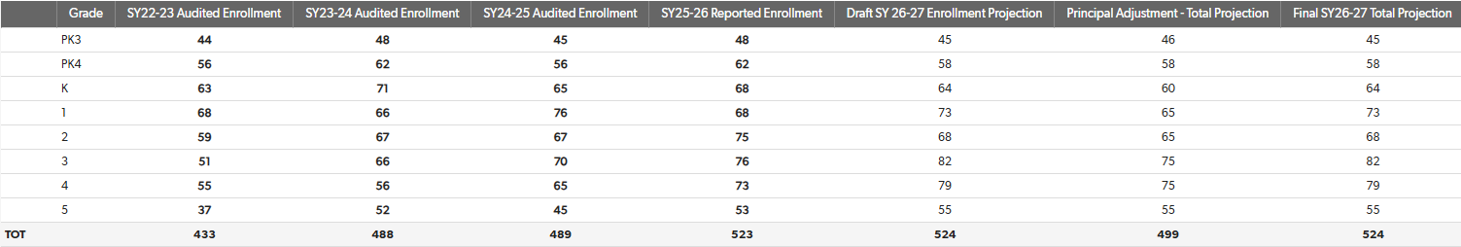
L-T Enrollment Projection: Update
DCPS Central rejected ALL Principal Miller’s adjustment requests
Its explanation was far from satisfying:
The ONLY change was +3 at risk slots. Change is +3 from projection and year-on-year; however, it is down considerably from last year’s over projection, so will decrease budget.
Note: This specifically refers to building capacity – aka the addition – which they not only promised would NOT be used to increase enrollment, but still isn’t finished.
However, DCPS’ School Planning team did meet with Principal Miller and assure her that they NOT use the projections to justify offering additional lottery slots and, specifically, that they will zero out initially-offered slots in several grades.

Slide 6
L-T Enrollment Projection: Discussion
Principal Miller: Can you please provide additional detail/color on this meeting? How satisfied are you with this outcome?
As a result of the agreement on lottery slots, Principal Miller has asked the LSAT for input on how we can engage the community to ensure early enrollment.
Early enrollment is critical because this approach relies more heavily on the utilizing the lottery wait list.
New families with confirmed lottery-based places have until May 1st to enroll in Ludlow-Taylor or they forfeit their places.
This applies to all new ECE families.
This does not apply to any new IB families.
We would ideally have 100% enrollment vs non-enrollment from existing families by May 1st, so that all of our enrollment data and lottery decisions can be processed together.
What is a realistic target percentage?
How can we achieve it?
“Enrollment Saturday” is April 26, if helpful.

Slide 7
SLP Services

Slide 8
SLP Services: Update
As of the November LSAT Meeting:
Ludlow-Taylor has not had a Speech-Language Pathologist (SLP) during this school year.
52 L-T students have IEPs requiring the provision of speech services.
The LSAT, PTO & 160 members of the L-T community sent a letter to the Chancellor on November 12th. The letter asked for a substantive response by November’s LSAT meeting. No such response arrived.
Shortly after our November LSAT meeting, on December 5th, Ms. Ward notified me that we had a new SLP, Ms. Ibtissem Rekik, who had begun observing students and would begin attending meetings and providing services the following week.
Questions for Principal Miller:
Questions re: substance of SLP services provision
Are all 52 students with speech-related IEPs receiving services from Ms. Rekik?
Is she able to keep up with ongoing hours requirements?
Are whatever groups are in place to permit bulk service provision appropriately sized and tailored?
Will she be able to make any dent in owed hours?
Questions re: communication regarding SLP service provision
Has Ms. Rekik reached out to parents of students to whom she is providing services?
Have families received any communication re: hours owed, current service provision, etc?

Slide 9
L-T Staffing Updates

Slide 10
L-T Staffing Updates
As of the November LSAT meeting, we had only 1 staffing vacancy: a special education aide position in the CES K-2 classroom.
Principal Miller: Has that position been filled? Are efforts still being made to fill it?
During the holiday break, we received an email about the immediate retirement (following medical leave) of our rockstar ELA Instructional Coach Ms. Toussaint.
Principal Miller: Has or will that position be filled for the remainder of this year?
Given (I imagine) the difficulty in filling that position mid-year, is there any flexibility regarding the use of funds for a temporary related position?
If the position is not filled and especially if it will not be, what is the plan for coverage for Grades 3-5 (especially as we approach the DC CAPE)?
Do you have any current thoughts that you can preview on whether we will plan to retain/hire for that position in future years?
I have heard through the grapevine of the arrival of a Mr. Hardy.
Principal Miller: Who is he/what position does he fill?
(When) will he be introduced to the community?
How is his position being funded?

Slide 11
Addition Updates

Slide 12
Addition Updates
For the third (or fourth, depending on how ones counts) time, DCPS has delayed the opening of the new addition. The latest occupancy date is February 13th.
DCPS has still not notified the FIT Committee about this delay or about any reason for it. (Nor was there any explanation given for the last delay.)
Ms. Berry – the DCPS POC for the FIT Committee – has not responded to the January 15th email I sent her asking if there was indeed a delay. (This was prior to Principal Miller’s confirmation of the same on the following day.
Questions for Principal Miller:
Can you tell us anything more about the latest delay? When was the most recent delay communicated to you? What explanation (if any) was offered)?
Are you confident that February 13th is actually the final date?
Have they given you any information about how this has pushed back the timeline for the field reconstruction, which was supposed to follow this summer’s completion?
Do you think the LSAT reaching out to DCPS to express our discontent about the constant delays and lack of information provided is likely to have any positive effect on completion?

Slide 13
Community Survey re: Budget Priorities

Slide 14
Community Budget Survey: Background
DCPS has circulated a Microsoft Forms-based customizable “School Priorities Survey” to LSAT Chairs with the following instructions:
“As we begin preparations for the upcoming budget season, we want to ensure that every school community has the opportunity to share feedback on its priorities. To support this work, we are asking each LSAT to duplicate and distribute the School Priorities Survey to gather input from families, staff, and other stakeholders.”
Historically, the L-T LSAT has surveyed the community about budget priorities using a Google Form and has asked similar (though more comprehensive) questions.
The next slides contain screenshots of the substantive questions in the DCPS survey and last year’s LSAT survey to guide our discussion. I think it makes sense to go through the latter and discuss what we might want to change/add/eliminate.
Principal Miller: Any guidance from DCPS (e.g., re: what the budget will look like next year) or initial thoughts from you to keep in mind when formulating either budget-related or other questions?

Slide 15
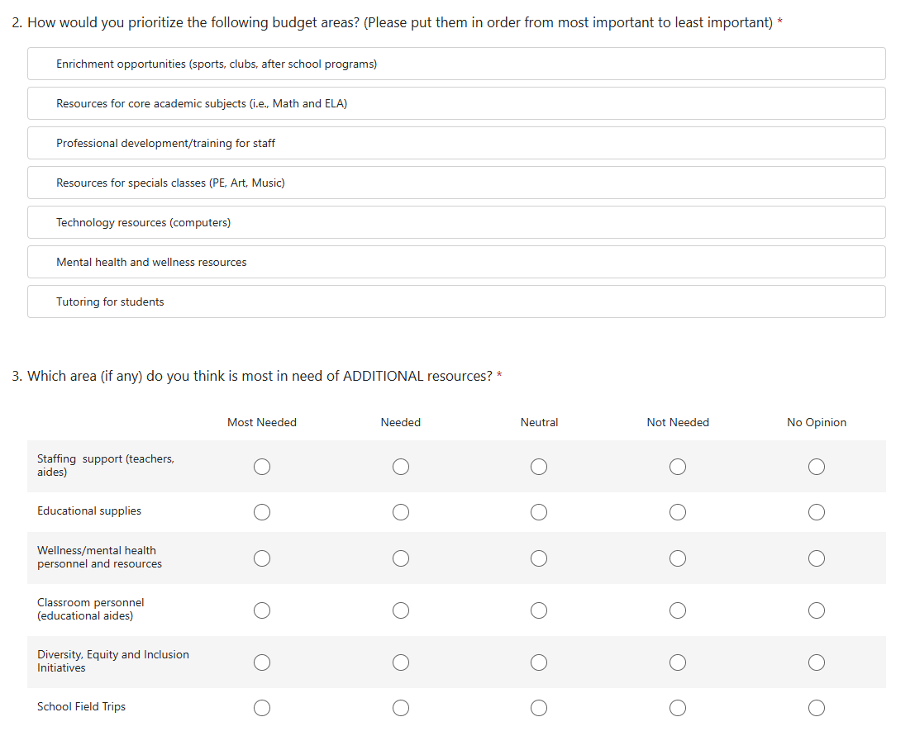
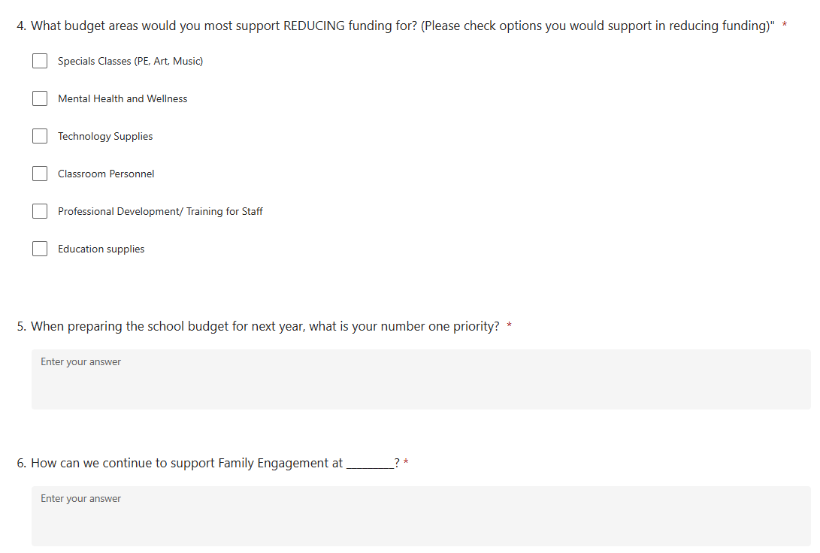
Community Budget Survey: DCPS Survey

Slide 16
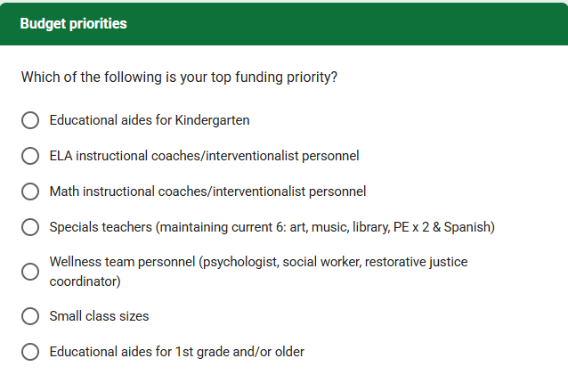
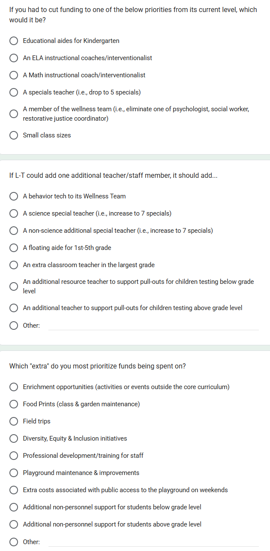
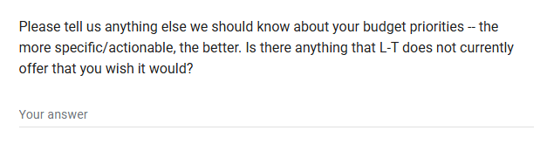
Community Budget Survey: 2025 LSAT Survey Budget Questions
Top 3
Top 2

Slide 17
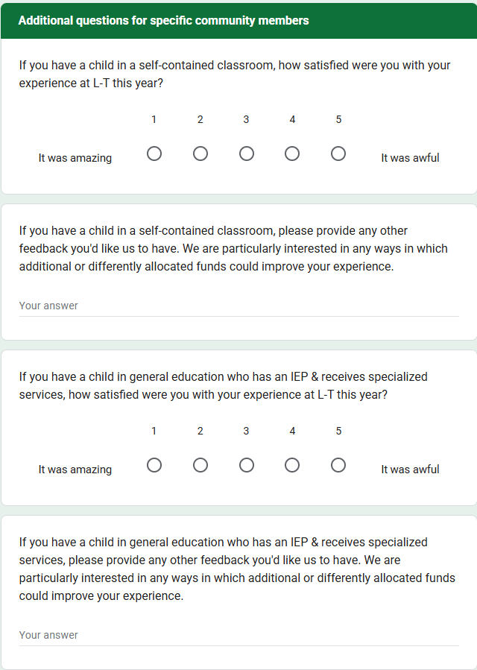
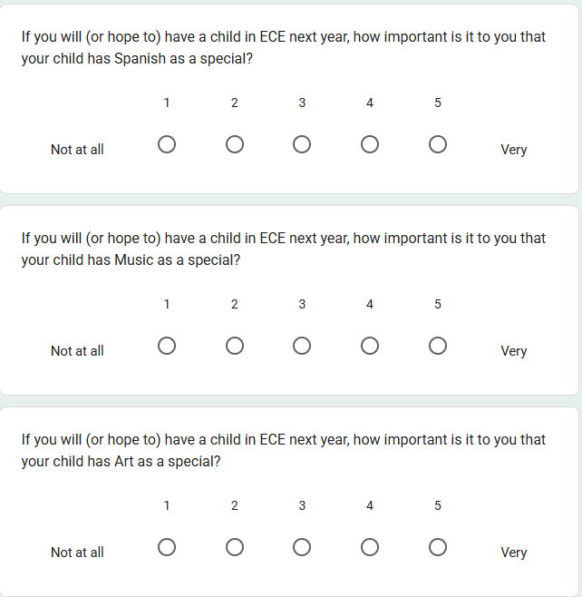
Community Budget Survey: 2025 LSAT Survey Additional Questions

Slide 18
Any Other Business & Questions

Slide 19
Good night.

