Slide 1

Ludlow-Taylor Elementary School February LSAT 2026 Meeting
2.23.26

Slide 2
Agenda
L-T’s Initial FY27 Budget
Principal Miller’s Overview
Open discussion / questions from L-T Community
Closed discussion: LSAT Members only

Slide 3

L-T’s Initial FY27 Budget

Slide 4
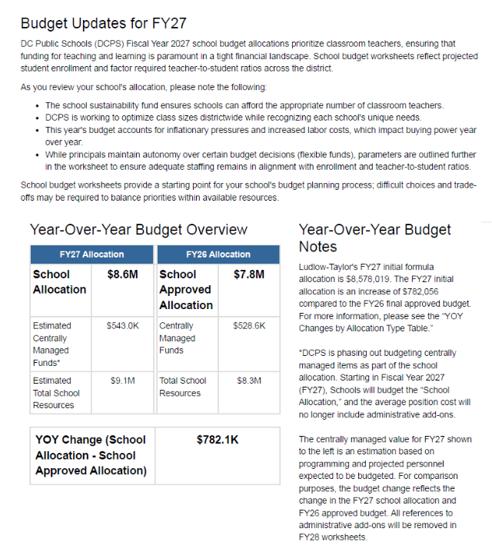
L-T FY27 Budget: Initial Allocation

Slide 5
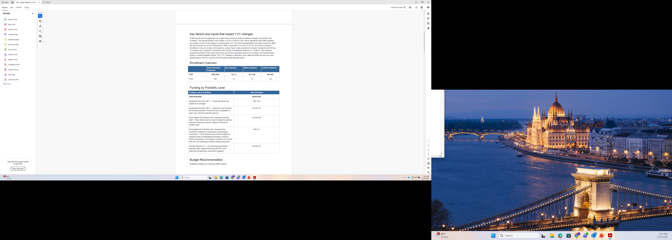
L-T FY27 Budget: By Flexibility Level

Slide 6
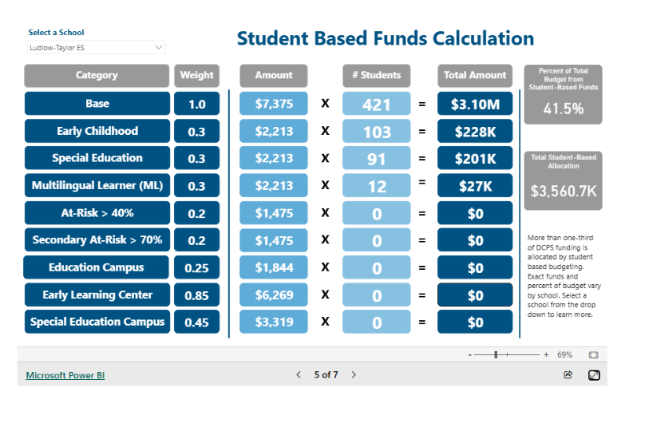
L-T FY27 Budget: How is it calculated?

Slide 7
L-T FY27 Budget: Year-on-Year Changes

Slide 8
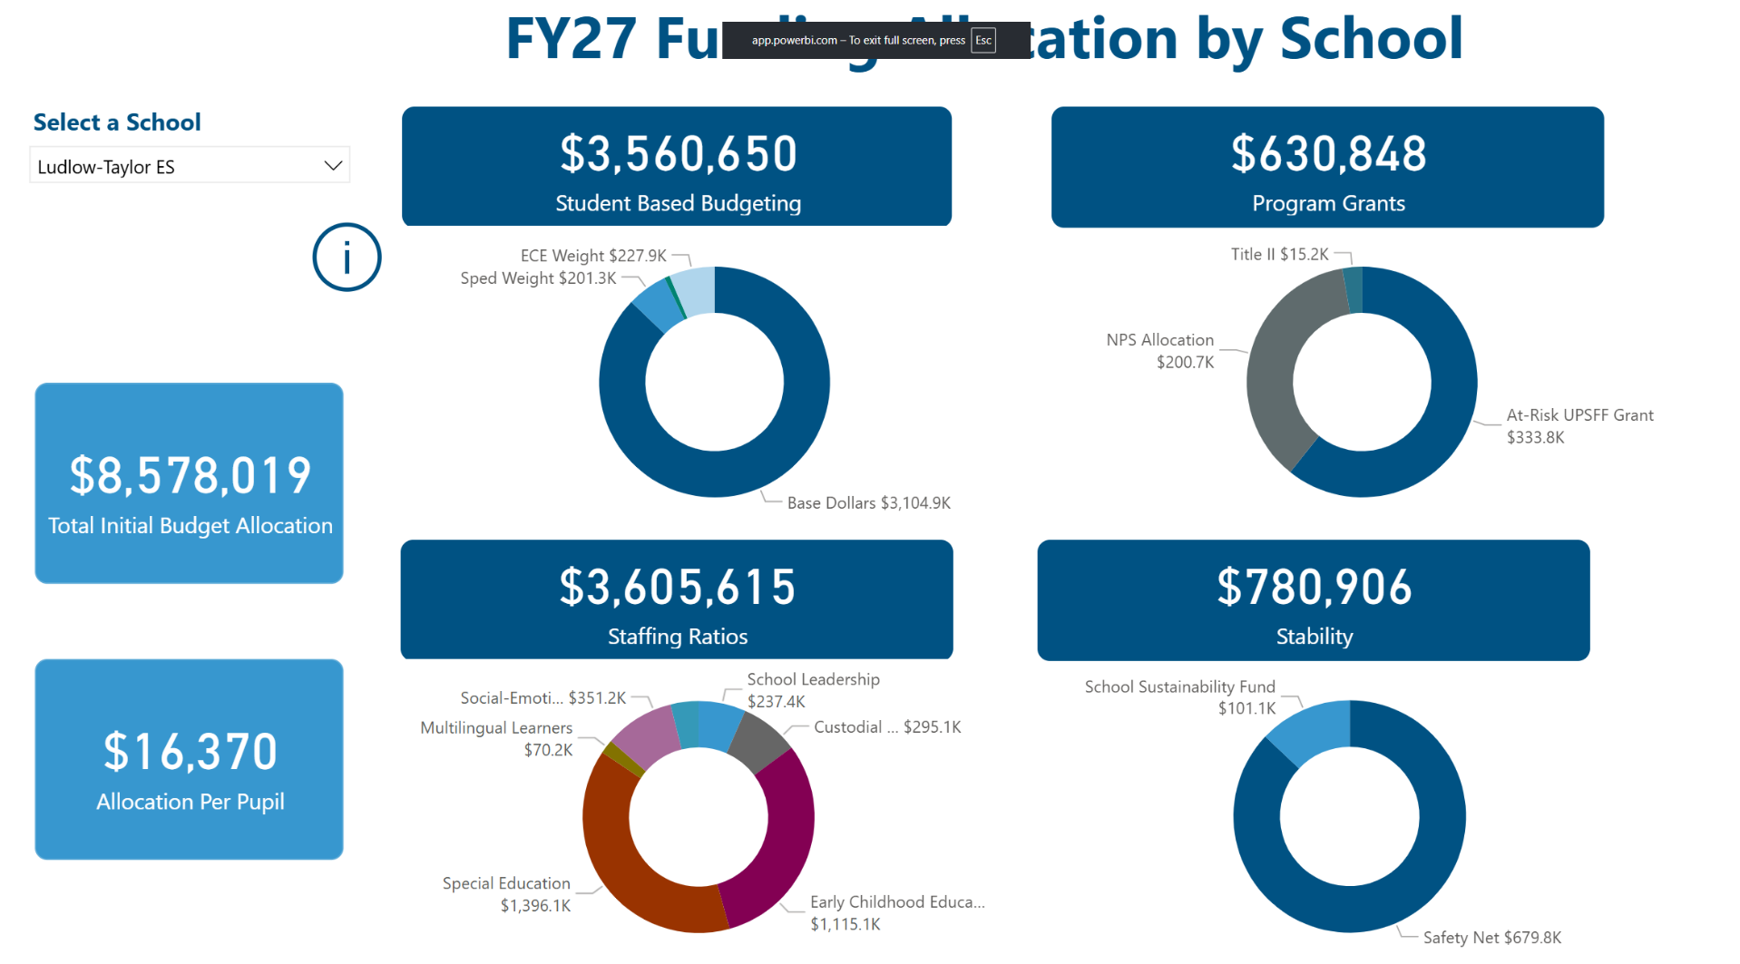
L-T FY27 Budget: How is it calculated?

Slide 9
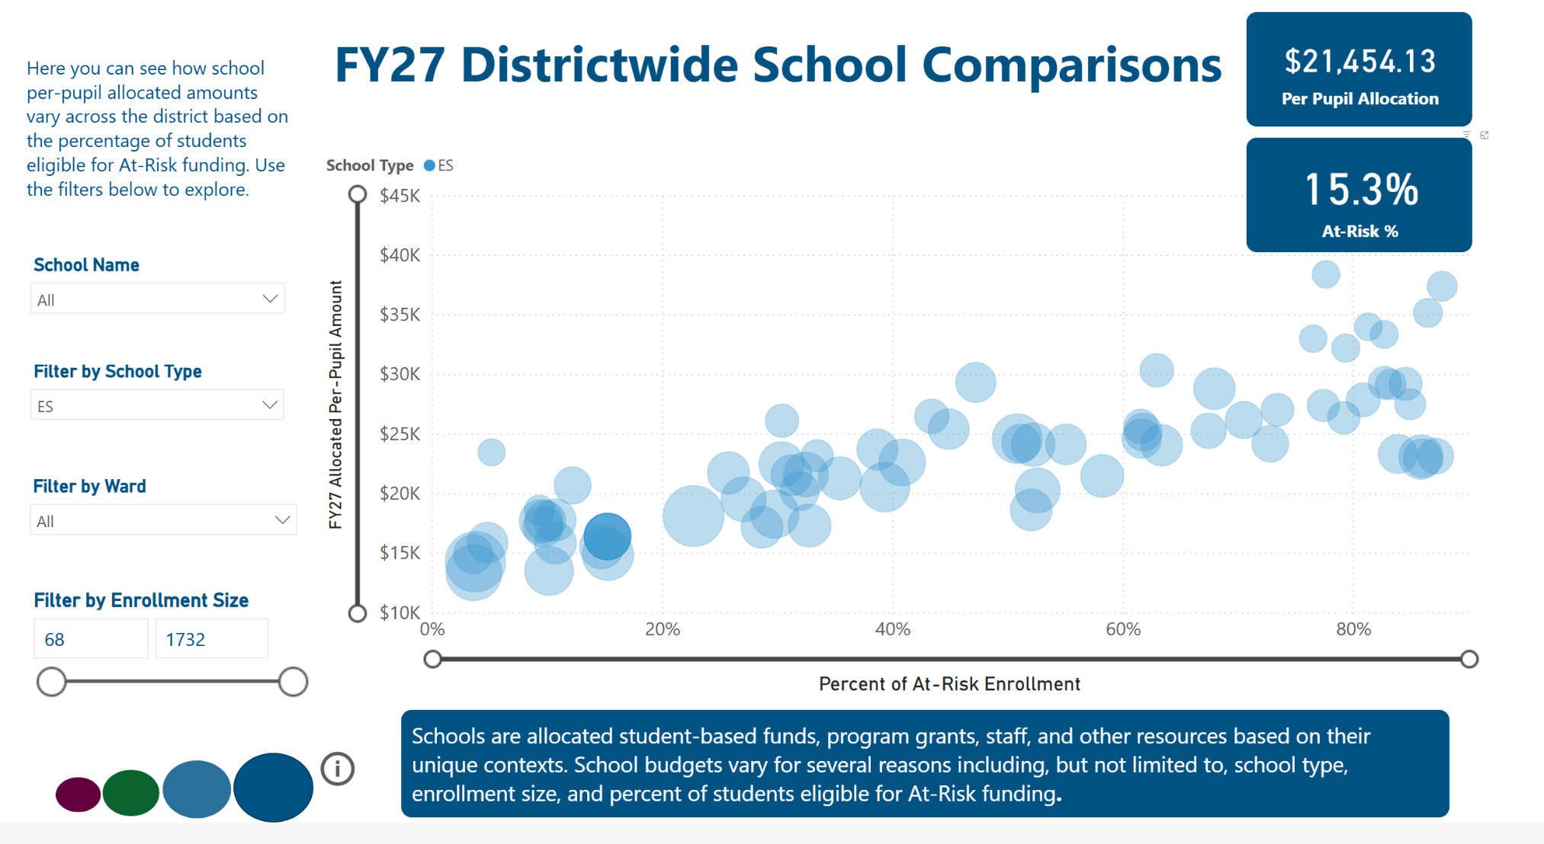
L-T FY27 Budget : How does it compare?

Slide 10
Principal Miller’s Overview

Slide 11
Open Discussion/ Questions

Slide 12
Open Session of the LSAT Meeting has ended. Good night.

