Slide 1

LT Learning Lab: DC CAPE
Presentation subtitle

Slide 2
Agenda
Whats' covered in the tests – math, ELA & writing, science
Schedule – weeks, days, time
Accommodations
Actual testing experiences for kids -
  Time, stress, day, week, celebration or how to make it less stressful
Sample test for caregivers – give them a few minutes to look through
How to help your kids through the test

Slide 3

What is DC CAPE?
DC Comprehensive Assessments of Progress in Education
Annual assessment that measures students’ readiness for college and careers as identified in the Common Core State Standards (CCSS) and Next Generation Science Standards (NGSS)
Tests grade/course-level content knowledge and application in ELA/Literacy, Math and Science
Computer-based test with technology enhanced items
Most accommodations and accessibility tools are embedded in the platform
Data are used for district-wide instructional decisions and used by OSSE for the federally mandated accountability system

Slide 4
What is assessed on CAPE?
Reading Claims
Math
Reading Literature: Students read and demonstrate comprehension of grade-level complex literary text.
Reading Information: Students read and demonstrate comprehension of grade-level complex informational texts.
Vocabulary Interpretation and Use: Students use context to determine the meaning of words and phrases.
Writing – Written expression in response to a text; language conventions (grammar, punctuation, spelling), various forms of writing
Major content of the grade (based on CCSS) (ie-multi-digit addition, multiplication & division, fractions, time, data, decimals, line-plots, mass, measurement) [multiple choice, fill-in]
Supporting Content of the grade (based on CCSS) (ie-graphs, geometry, perimeter, area) [multiple choice, fill-in]
Mathematical reasoning [written response]
Modeling with math [written response]

Slide 5
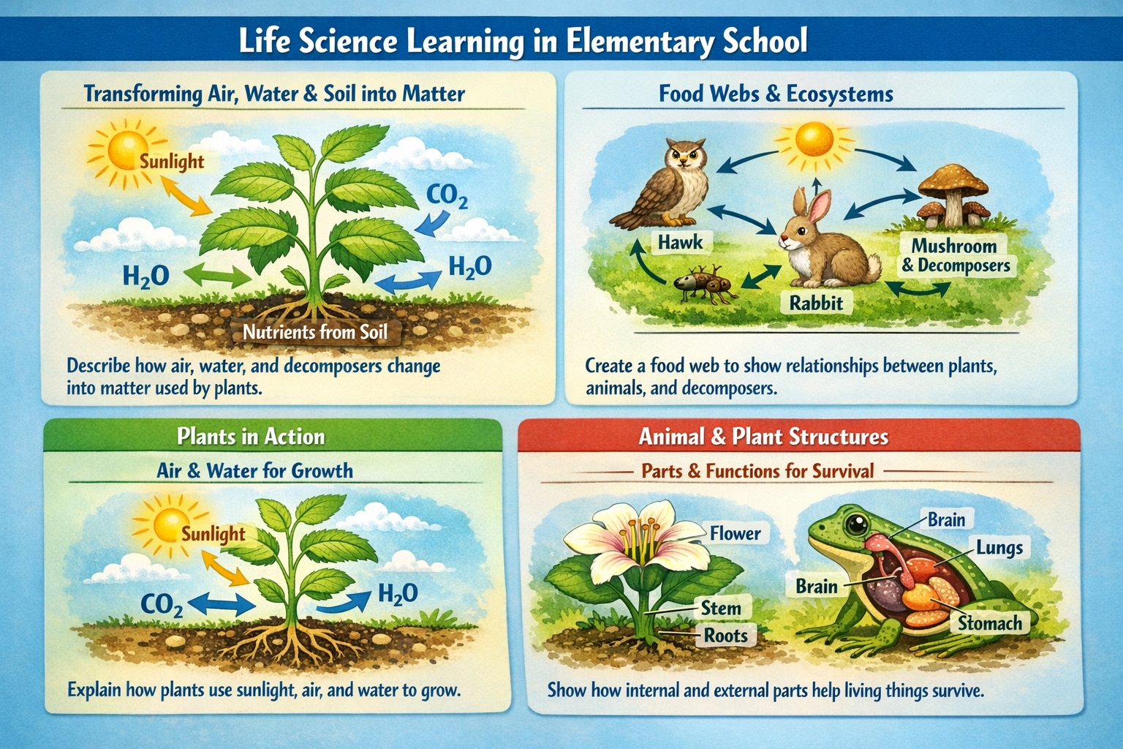

Slide 6


Slide 7


Slide 8
ELA Test Question Types & Tasks
Multiple‑choice with evidence (EBSR): Students pick an answer and the evidence that supports it. Some partial credit.
Tech‑enhanced questions (TECR): Drag-and-drop, highlight, or drop‑down items. Some have two parts. Partial credit possible.
Written responses (PCR): Longer writing tasks worth more points (12–19), scored by machine or by hand.
Literary Analysis Task (LAT): Compare two stories; includes several short questions plus one writing response.
Research Simulation Task (RST): Read 2–3 informational texts and combine information; includes short questions plus one writing response.
Narrative Writing Task (NWT): Read one story and write a narrative response; includes a few short questions.
Short/Long Passage Sets: Only short questions—no writing. Short sets have 4 questions; long/paired sets have 6.

Slide 9
Math Test Question Types & Tasks
Type 1 tasks assess concepts, skills, and procedures. These tasks are worth one, two, or four points.
Type 2 tasks assess mathematical reasoning. These tasks are worth three or four points.
Type 3 tasks assess modeling or application. These tasks are worth three or six points.
Each task type can be assessed with multiple choice (MC), multiple select (MS), fill-in-the blank (FIB) or technology-enhanced interactions (TE). All tasks are standalone.

Slide 10
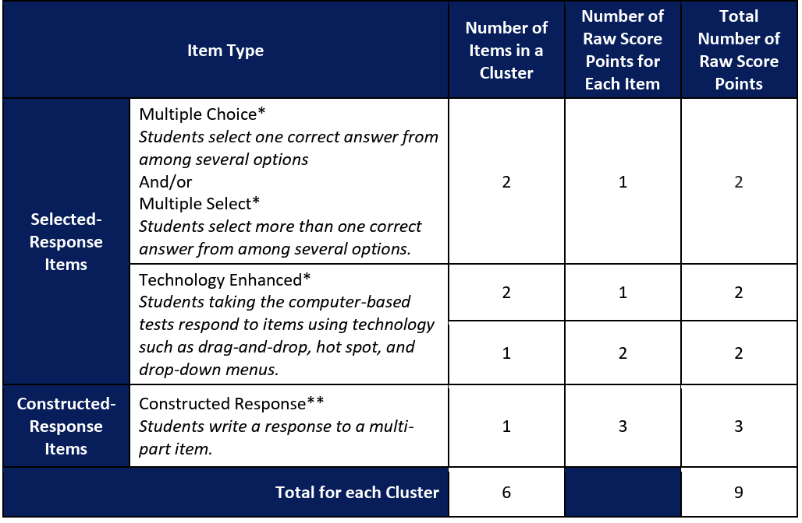
Question Types:

Slide 11
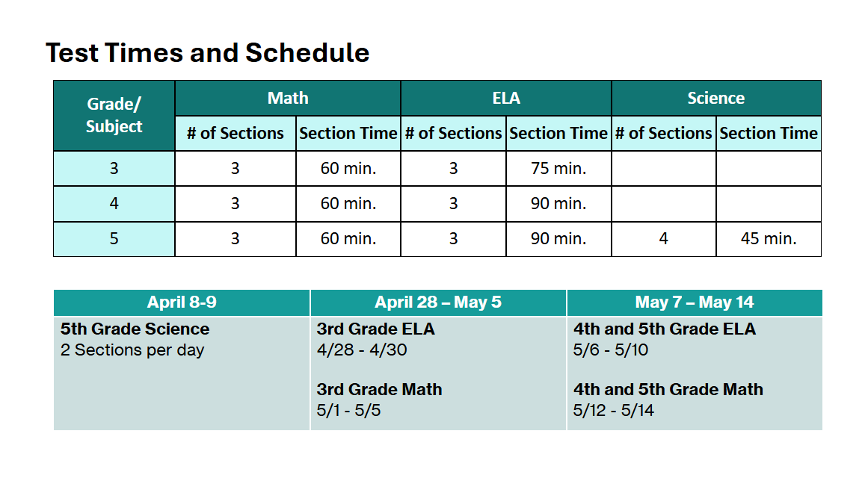

Slide 12
Testing Schedule
Monday | Tuesday | Wednesday | Thursday | Friday
4/27 | 4/28 Gr 3 ELA | 4/29 Gr 3 ELA | 4/30 Gr 3 ELA | 5/1 Gr 3 Math
5/4 Gr 3 Math | 5/5 Gr 3 Math | 5/6 Gr 4/5 ELA | 5/7 Gr 4/5 ELA | 5/8 Make-ups
5/11 Gr 4/5 ELA | 5/12 Gr 4/5 Math | 5/13 Gr 4/5 Math | 5/14 Gr 4/5 Math | 5/15 Make-ups
5/18 Make-ups | 5/19 Make-ups | 5/20 Make-ups | 5/21 Make-ups | 5/22 Make-ups

Slide 13
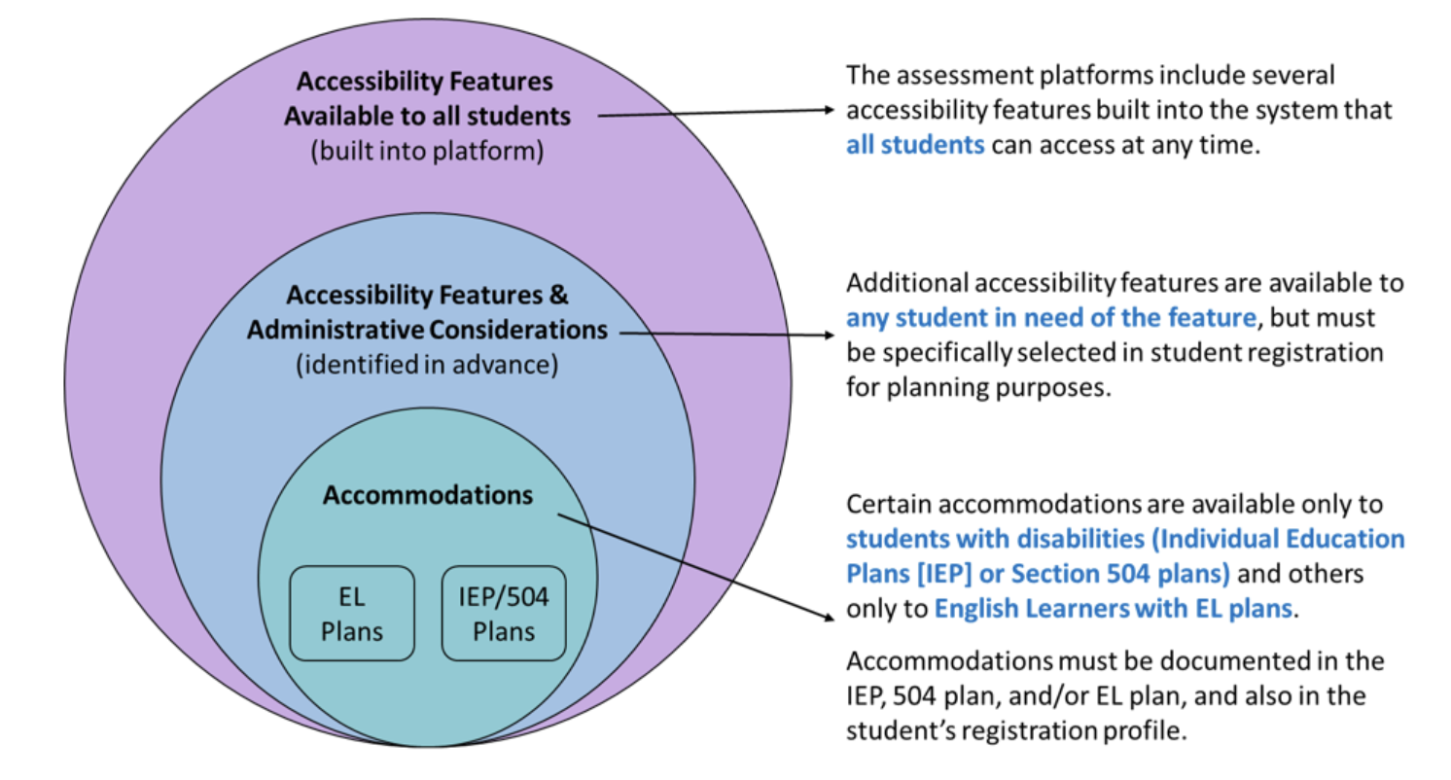
Student Accommodations

Slide 14
Understanding Testing Accommodations (For Families)
Students with an IEP, 504 Plan, or English Learner (EL) plan may receive testing accommodations. These are supports that help students access the test fairly, not ways to change what the test measures.
Key points:
Accommodations help students show what they know by reducing the impact of a disability or language needs.
They do not change the difficulty or expectations of the test.
Accommodations must be approved ahead of time in the student’s official plan.
Some accommodations are built into the online test, while others are provided by the test administrator.
Students should receive the same accommodations they use in class—nothing new on test day.
The goal: Give students fair access without lowering standards or changing what the test is designed to measure.

Slide 15

What It's Like for Kids...
Timing:
  Testing begins after Strong Start
Environment:
  Test in homerooms (no accommodations) or pulled to other spaces on the 3rd floor (accommodations)
  Walls are blank or covered except for calendars and motivational posters
  Tests are separated and in rows
  During testing, room is silent
They get:
  Treats -not unlimited, but enough to make it novel and interesting
  Extra time outside
  Opportunities to show what they know

Slide 16
Sample Questions

Slide 17
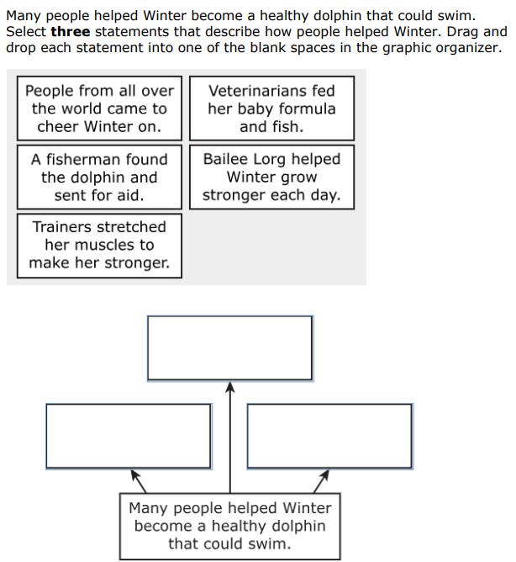
3rd Grade ELA

Slide 18
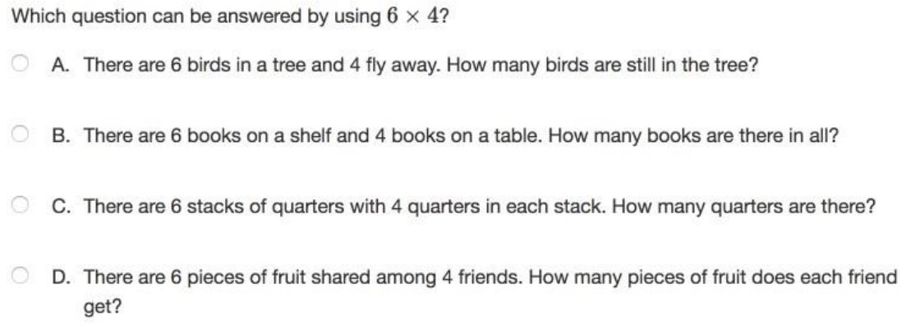
3rd Grade Math

Slide 19
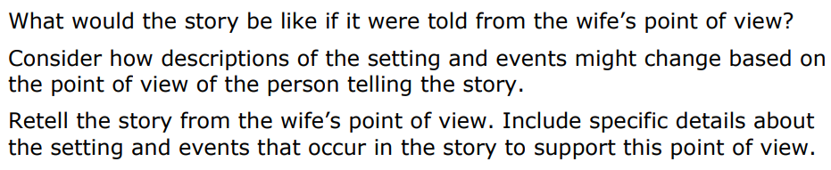
4th Grade ELA

Slide 20
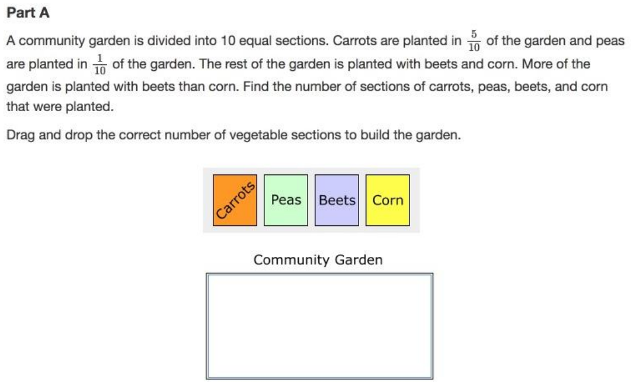
4th Grade Math

Slide 21
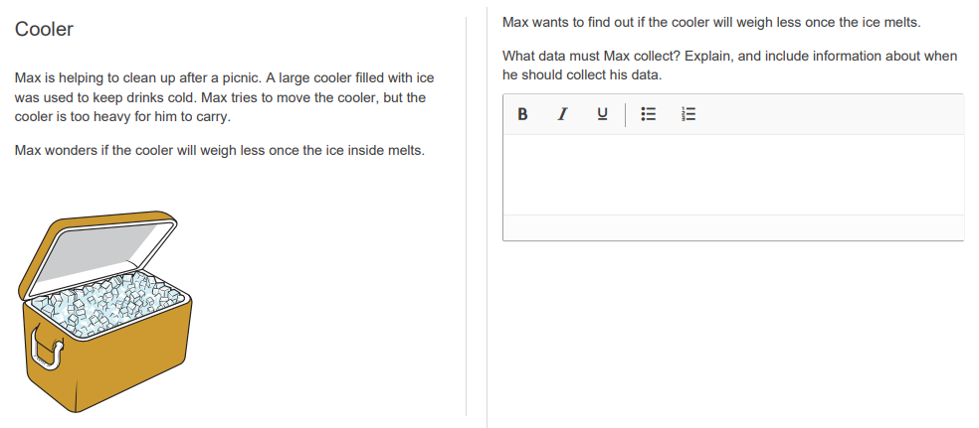
5th Grade Science

Slide 22
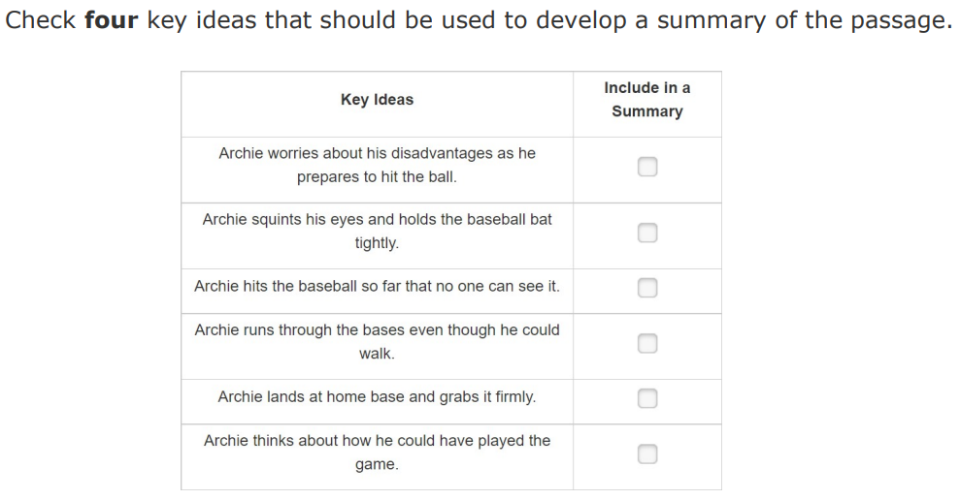
5th Grade ELA

Slide 23
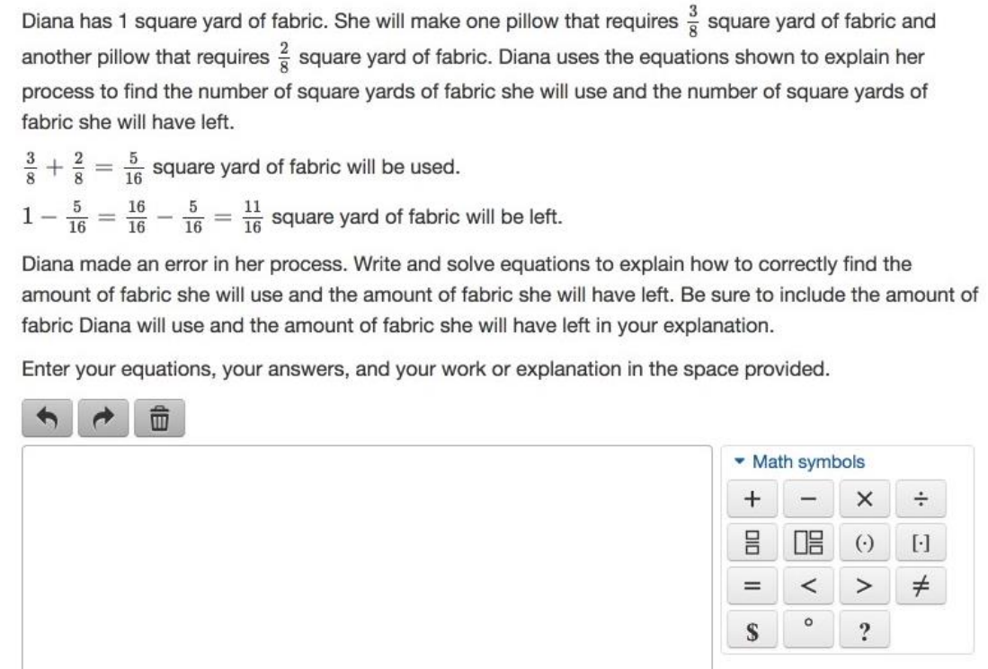
5th Grade Math

Slide 24
Links for More Information
DC CAPE https://dc.mypearsonsupport.com/test-design.html
Testing Accommodations: https://osse.dc.gov/service/testing-accommodations
Practice Tests: https://dc.mypearsonsupport.com/practice-tests.html
Washington Post Article explains CAPE

Slide 25





How to Survive Testing

