Slide 1

Ludlow-Taylor Elementary School November LSAT Meeting
11.18.25

Slide 2
Agenda
Prior LSAT Meeting Follow-up
Lack of Speech Therapist (SLP) at L-T for SY ’25-’26
Questions re: general provision of SpEd services
Family engagement with educational data & Principal Miller’s “Score Sense” presentation
Enrollment projections
Community Suggested Topic: Construction Noise
Any Other Business / Questions from Non-LSAT Members

Slide 3

Special Education Services @ L-T

Slide 4
Missing SLP Services for SY ’25-’26: Where are we now?
Ludlow-Taylor has not had a Speech-Language Pathologist (SLP) during this school year.
52 L-T students have IEPs requiring the provision of speech services.
None of those 52 students has received any speech services, except that 1 SLP came to L-T on 1 occasion to work only with ECE students.
Neither DCPS nor L-T has provided any update to families with children missing services since September 5th.
Following discussions at the September and October LSAT meetings, the LSAT, PTO & 160 members of the L-T community sent a letter to the Chancellor on November 12th. The letter asked for a substantive response by today in light of today’s LSAT meeting.
Two hours after the letter was sent, Principal Miller informed the LSAT that an SLP had been identified and assigned to L-T and would begin the following day.
Two hours after that, Principal Miller informed the LSAT that that SLP resigned from DCPS.
I sent a follow up note of concern to the Chancellor. He sent a reply which appeared to misunderstand the nature of my concern and suggested he had not read the original letter. Specifically, he chastised me for requesting confidential information about the reason of the (unnamed) SLP’s resignation and promised “minimum interruption” to SLP services at L-T.
After my clarifying follow up note, there has been absolutely no reply from DCPS.

Slide 5
Special Education Services at L-T: Got Questions?
Over the past few LSAT meetings, stemming back to last year (if not earlier), it has been clear that there are many questions about the provision of Special Education services at L-T, as well as communication around the same.
At the October LSAT meeting, in addition to the issues with missing SLP hours, we discussed that there were still gaps and discrepancies in communications regarding the 14 then-3rd grade students who were missing hours heading into the last few months of last year.
Questions about the particulars of missing hours & efforts to make them up were still live as of 2 weeks ago, when one parent cc’ed the LSAT account on her latest attempt to get answers.
Last Saturday, Ms. Stephanie Ward, L-T’s Special Education Coordinator, called me and offered to answer a written list of questions compiled by the LSAT after input from the L-T community.
Earlier this week, I sent out an email to the community seeking its input/questions.

Slide 6
Special Education Services at L-T: Got Questions!
1. Could L-T affirmatively send out a report of missing services hours (specifically thinking of speech, but also if any other hours are missing) as of the end of Term 1? If not, is there a POC for parents to find out the number of speech hours that DCPS believes their child is missing?
2. Do we currently have complete and adequate SpEd staffing other than the SLP? Is the school up to date (within a reasonable margin) on all other service hour delivery?
3. How can we get more transparency between the special education staff and parents? Some parents have received no communication all year.
4. Given LT’s lack of services the last three years across special education, is there some type of accounting mechanism we can use to ensure students are getting their services? Several students have fallen through the cracks and parents were assured several times last fall that their students were getting services, when in fact we found out in February they were not.
5. How often should families expect to be hearing from their students’ case managers and/or service providers? What sort of content would they expect to get (i.e., Substantive updates? Technical compliance certification? Formal assessments?). If your child only receives speech services, who is their current case manager?
6. What are the accountability and performance measures the school is using to understand if it is complying with IEPs and the students are receiving the proper services. If students are not, how are you communicating that information in a transparent manner to the parents and school community?
7. Will the school allow for outside providers to come to the school during the day to provide services for kids who are currently not receiving any services from LT?

Slide 7
Data Analysis: Family Engagement

Slide 8
Data Analysis: Family Engagement Efforts
At the October LSAT meeting, at Principal Miller’s request, we discussed how the school could better engage families in supporting the growth of their students on iReady and DC CAPE metrics.
The LSAT suggested that better contextualizing students’ results for families – that is, explaining what the various metrics actually mean and how the school uses them – could help with family engagement.
This morning, in collaboration with the PTO Board, Principal Miller gave a “Score Sense” presentation along those lines as the first “Learning Lab.”
My personal feedback after attending: It was useful, needed & well-done. It would be more useful earlier in the year, broken down into smaller chunks and aimed at more specific audiences.
Discussion Questions:
Thoughts from Principal Miller & others?
Follow-ups? Perhaps facilitated by Ms. Broom and/or Ms. Toussaint?
Other topics ripe for Learning Labs?

Slide 9
L-T Enrollment Projections

Slide 10
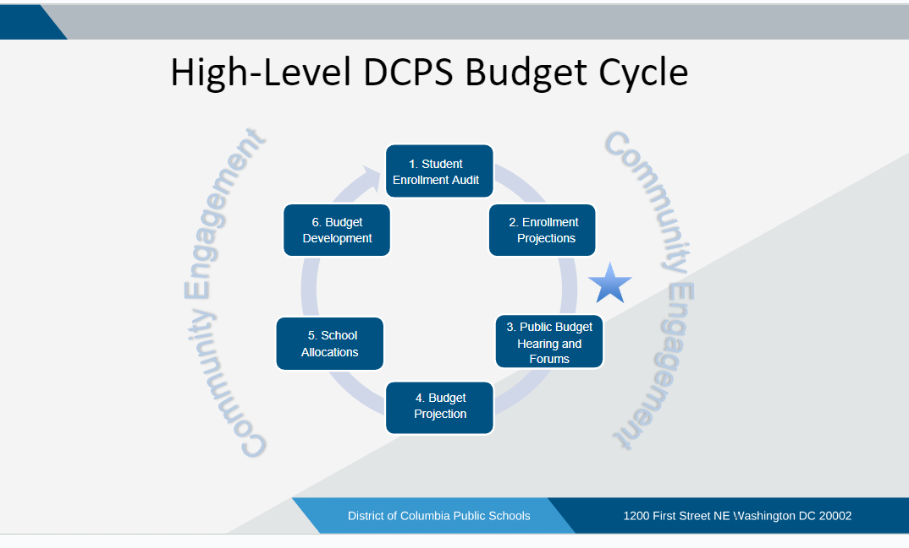
Enrollment within the DCPS Budget Process
Enrollment projections for each school are the chief inputs that DCPS uses to calculate individual school budgets (i.e., schools get $ per student and/or per class).

Slide 11
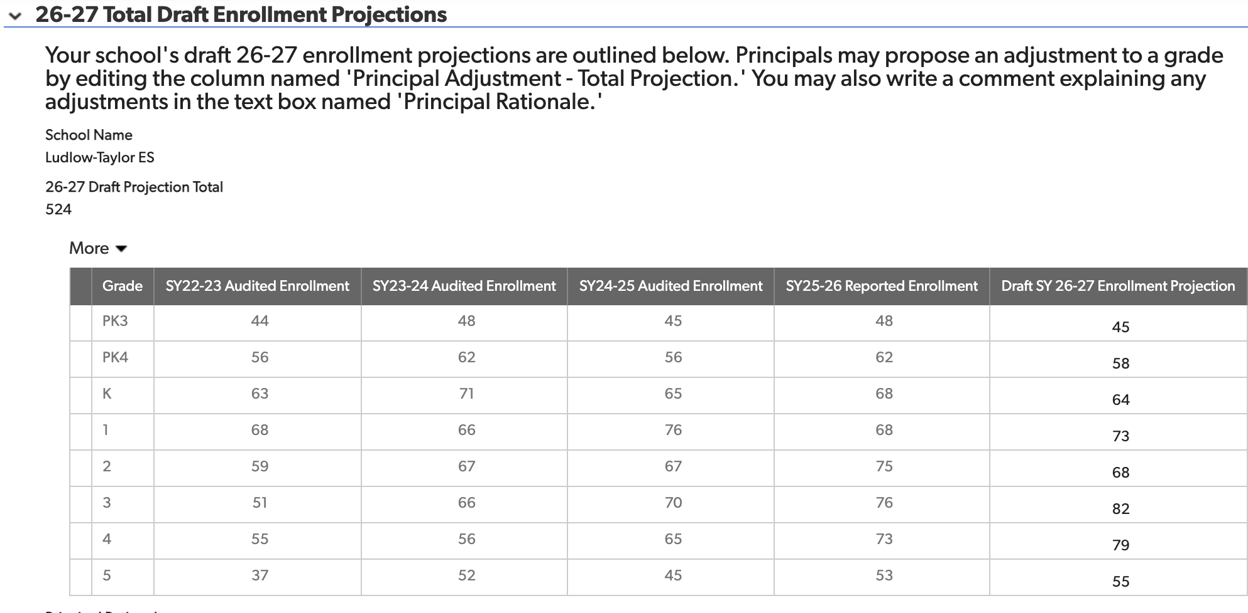
L-T Enrollment Projection: Students per Grade

Slide 12
Enrollment Projection: How’d They Do Last Year?
Grade Level | SY 25-26 Enrollment Projection | SY 25-26 Reported Enrollment | Difference
PK3 | 45 | 48 | -3
PK4 | 58 | 62 | -4
K | 63 | 68 | -5
1st | 68 | 68
2nd | 74 | 75 | -1
3rd | 68 | 76 | -8
4th | 71 | 73 | -2
5th | 53 | 53
TOTAL | 500 | 523 | -23 = FULL CLASSROOM
Why does this matter? Enough students for +1 teacher PLUS other funding.
A trend: EVERY YEAR except COVID year they’ve under-projected.
DCPS needs to project more OR offer fewer lottery spots OR both.

Slide 13
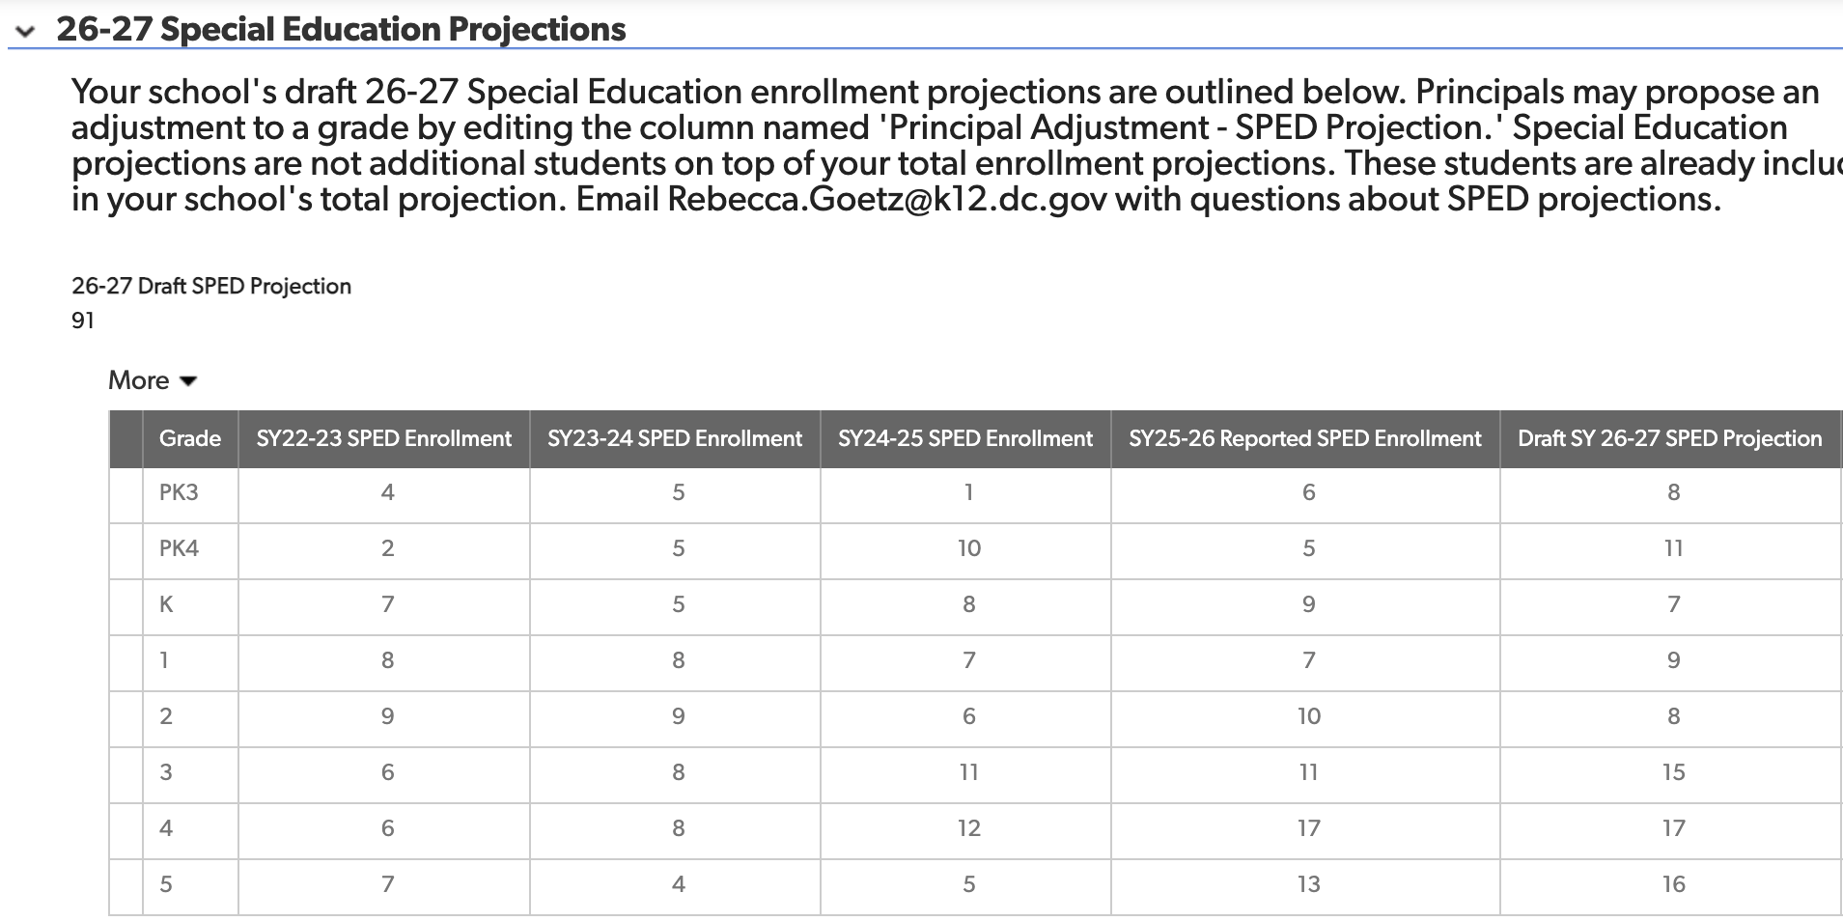
L-T Enrollment Projection: Special Education Students

Slide 14
SpEd Projection: How’d They Do Last Year?
Grade Level | SY 25-26 Enrollment Projection | SY 25-26 Reported Enrollment | Difference
PK3 | 1 | 6 | -5
PK4 | 4 | 5 | -1
K | 12 | 9 | +3
1st | 9 | 7 | +2
2nd | 6 | 10 | -4
3rd | 9 | 11 | -2
4th | 16 | 17 | -1
5th | 10 | 13 | -3
TOTAL | 67 | 78 | -11 = 16% OFF
Important to remember the number of IEPs tends to rise throughout the year (especially in middle ES grades), so this year’s numbers are minimum not total.
Projecting 91 for next year, so do seem to be compensating somewhat.

Slide 15
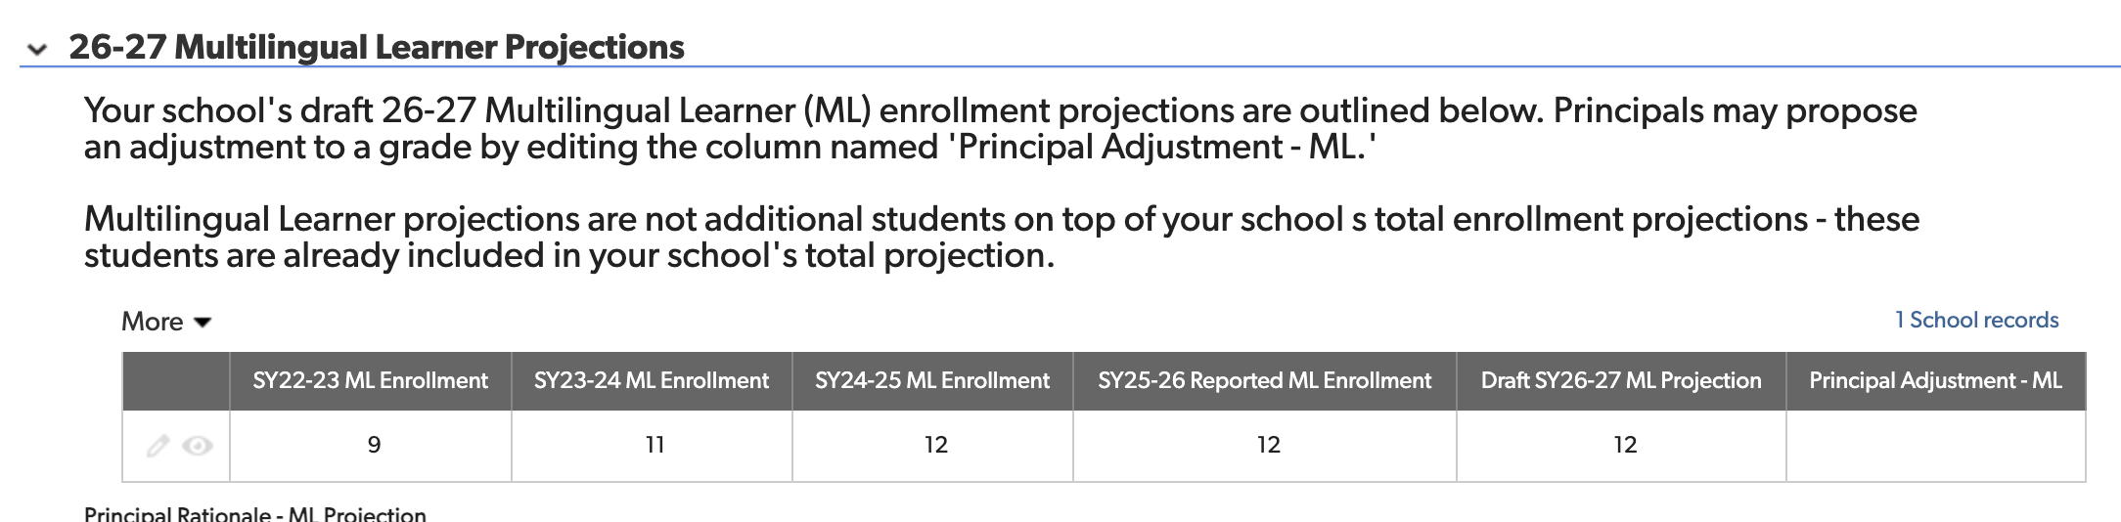
L-T Enrollment Projection: Multi-Lingual Learners
Last year they under-projected us by one and I believe that Principal Miller successfully adjusted it up one to 12 (which proved correct).
Although, unlike last year, they don’t show us how they arrived at this total, it seems reasonable in light of the stability of the past few years and will be enough to retain our .5 MLL teaching position.

Slide 16
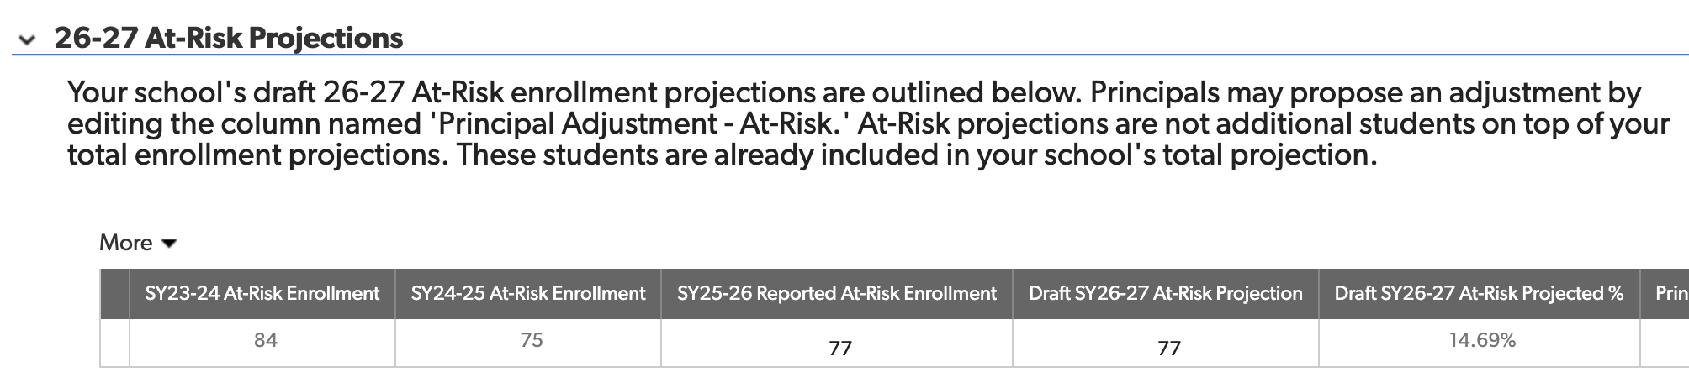
L-T Enrollment Projection: At-Risk Students
Last year, they projected that we would have 120 At-Risk students this year. That projection seemed entirely baseless, but there was no benefit to us arguing it down.
This year’s projection seems far more sensible – but will be a large budget hit, making push back on the other projections even more important.

Slide 17
Community-Suggested Topic: Construction Noise

Slide 18
Construction Noise: Incredibly Disruptive
Construction noise appears to have gotten substantially worse recently. MANY complaints and videos sent with loud drilling and vibrations in the classroom. Have heard reports of classes being moved to the hallway (e.g., Mr. Molloy’s 5th grade math class) on a regular basis because of the noise.
Most recent FIT Committee Update (received 11/14) does not offer a November meeting for Committee members and notes that the previously planned meeting for teachers re: moving logistics has been cancelled.
The Update also gives the move date as December 30th and no longer suggests that construction will be completed by Thanksgiving break. This is another MONTH of substantial disruption.
Principal Miller: Has the school had any communication with DCPS about the disruption? For instance, teachers have reported that Mr. Barnes has witnessed the disruptions, inquired about them and promised to liaise with DCPS.

Slide 19
Any Other Business & Questions

Slide 20
Good night.

