Slide 1

LLL Score Sense

Slide 2
Agenda
What are you looking at when you get a score report from CAPE or iReady?
What is the important information?
What are the difference between 1, 2, 3, 4, or well below, below, on, mid-above
Questions?

Slide 3
What is i-Ready? Why do we use it?
The i-Ready Diagnostic
An adaptive assessment that adjusts its questions to suit your student’s instructional priorities.
Each item a student sees is individualized based on their answer to the previous question.
A series of correct answers will result in slightly harder questions, while a series of incorrect answers will yield slightly easier questions.
i-Ready Personalized Instruction
Students are assigned a sequence of lessons (My Path) based on their needs as assessed by the diagnostic.
Students have an individualized learning path for each domain.
Teachers can also assign lessons based on instructional priorities.

Slide 4
What does I-ready assess?
ELA
Math
Phonological Awareness
Phonics
High-Frequency Words
Vocabulary
Comprehension
Informational Text
Literature
Numbers and Operations
Algebra and Algebraic Thinking
Measurement and Data
Geometry

Slide 5
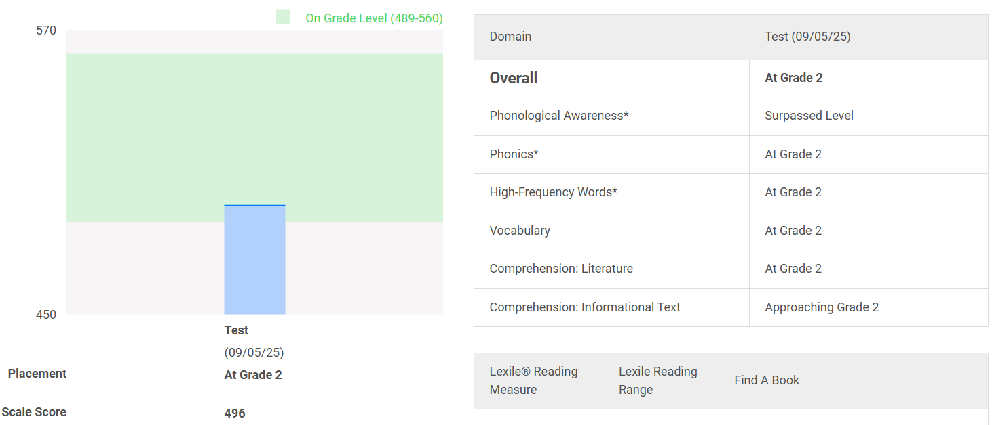
Sample family report- 2nd Grader

Slide 6
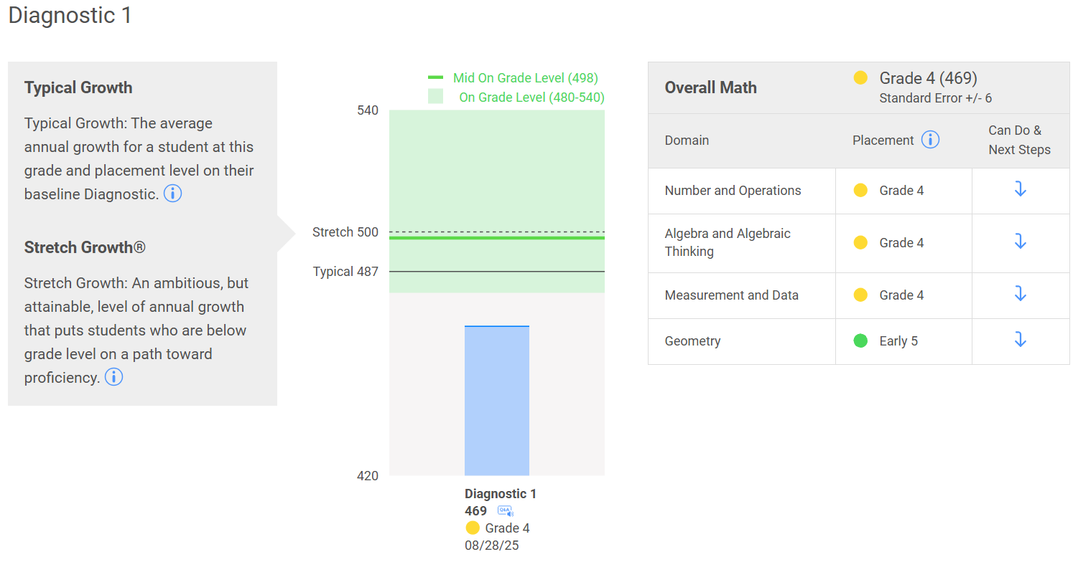
Sample results report – 5th Grader

Slide 7
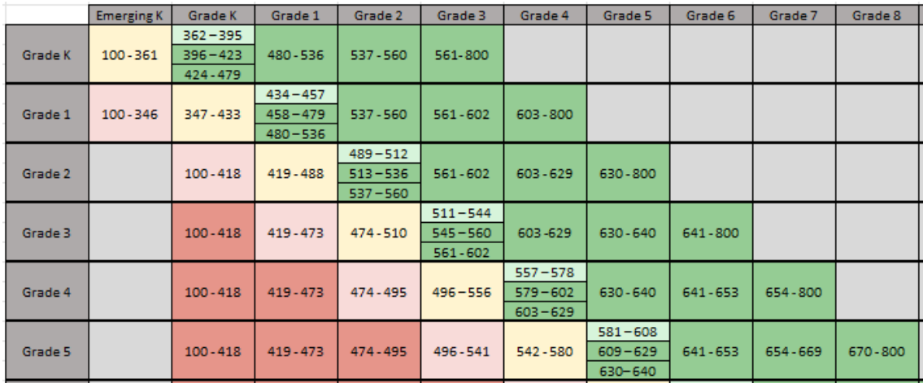
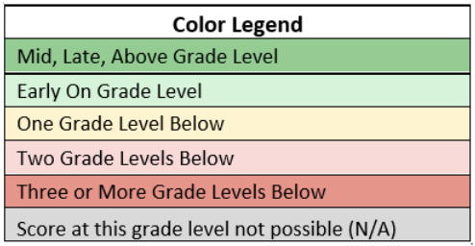
I-Ready Reading Score ranges

Slide 8
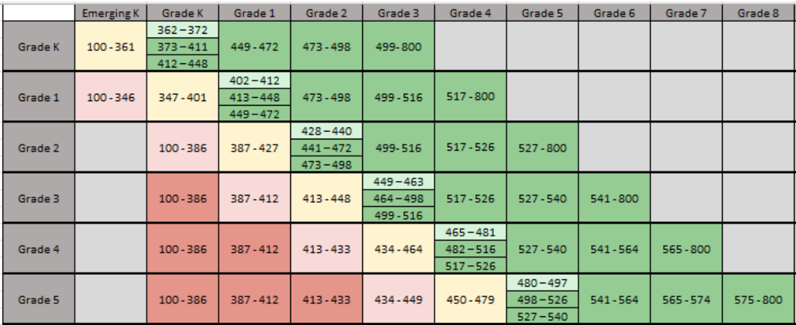
I-Ready Math Score Ranges

Slide 9
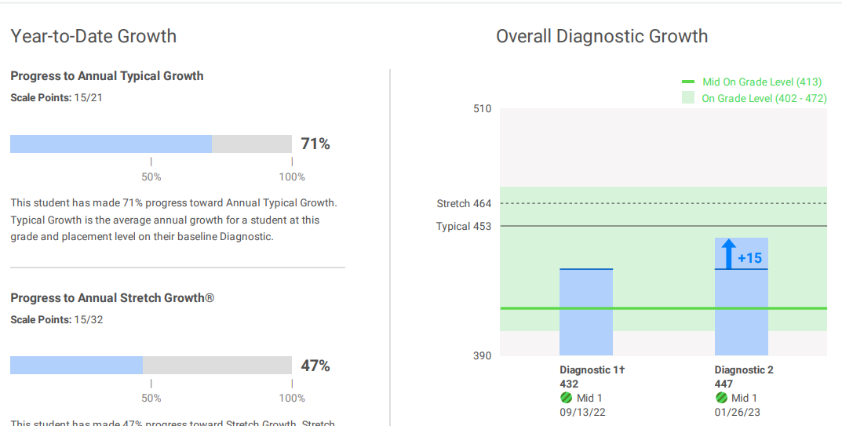
Coming up: Mid-year growth – 1st Grader beginning on level

Slide 10
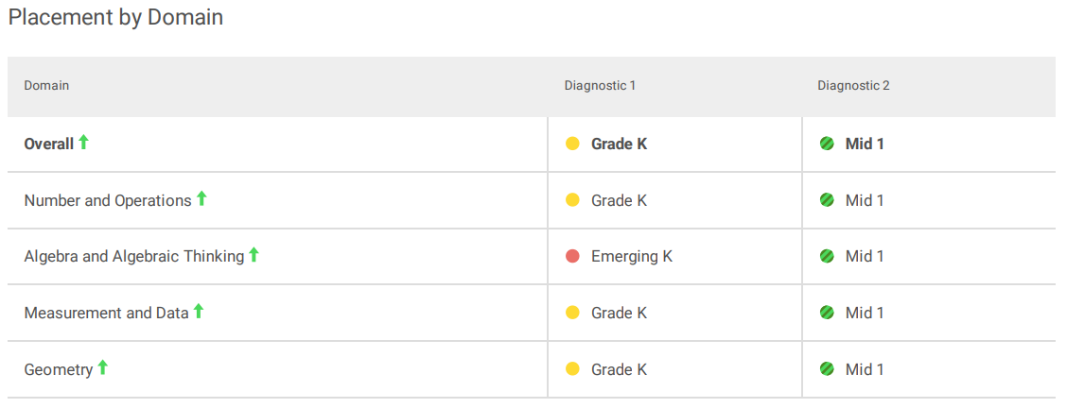
Coming up: Mid-year growth – 1st Grader beginning below grade level

Slide 11
CAPE – Comprehensive Assessment of Progress in Education
Assessment of grade level skills of reading, writing, math, and science (only in 5th grade)
Assesses student's performance against the Common Core State Standards (CCSS) and the Next Generation Science Standards (NGSS)
Students take a series of assessments at the end of the year
Students receive scores based on their knowledge and performance and schools receive ratings of how they are preparing students compared to Common Core State Standards
Scores are in a range

Slide 12
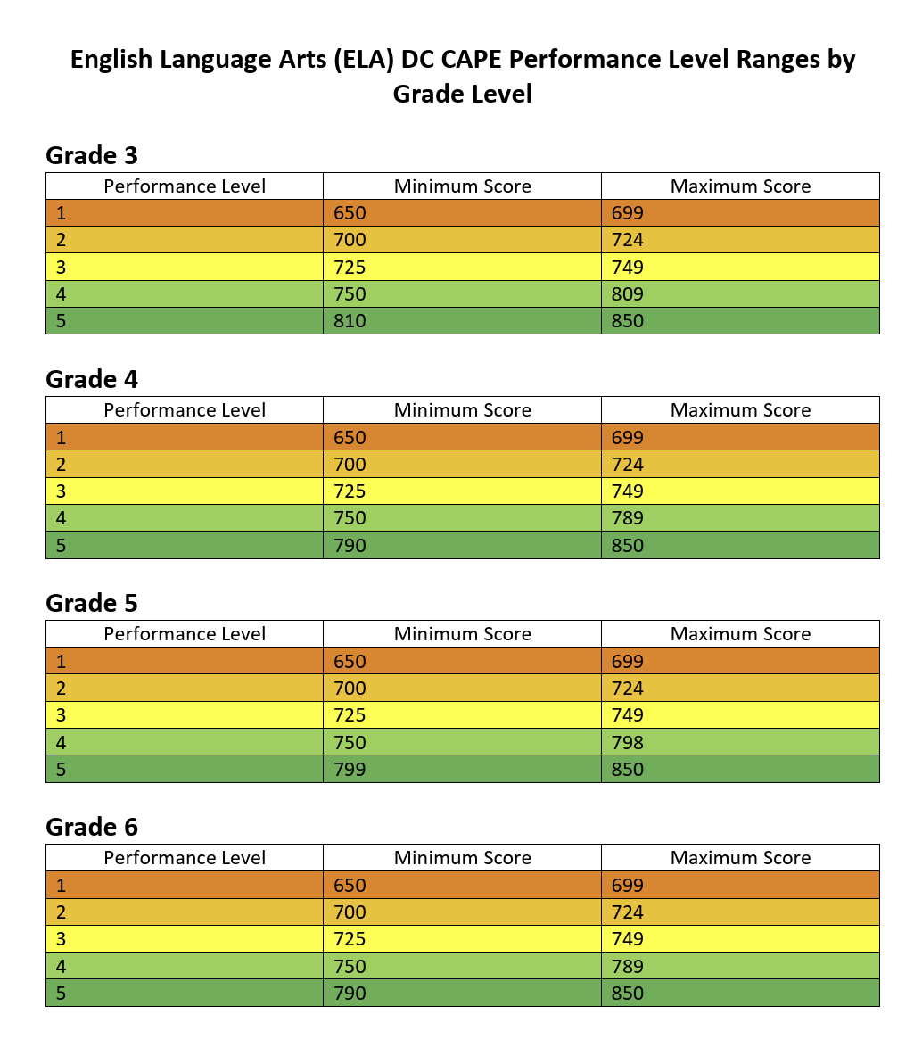
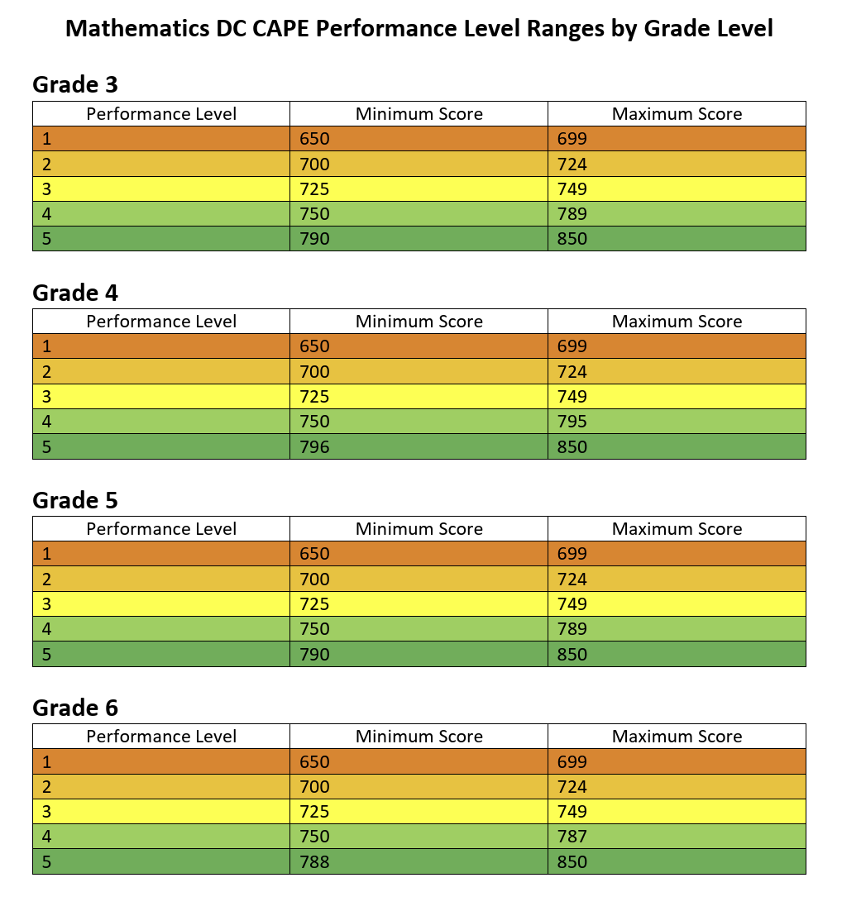
Score ranges
Math
ELA

Slide 13
What is assessed?
Reading
Math
Reading comprehension - literature; informational; vocabulary
Writing – Written expression in response to a text; language conventions (grammar, punctuation, spelling)
Major content of the grade (based on CCSS) (ie-multi-digit addition, multiplication & division, fractions, time, data, decimals, line-plots, mass, measurement) [multiple choice, fill-in]
Supporting Content of the grade (based on CCSS) (ie-graphs, geometry, perimeter, area) [multiple choice, fill-in]
Mathematical reasoning [written response]
Modeling with math [written response]

Slide 14
What does my kids score mean? - Literacy
A score of 4 or 5 = your child can read grade level text with full comprehension, write about that text with clarity, and has mastery of vocabulary and grammar.
A Score of 2 or 3 = your child may have some difficulty reading grade level text (either decoding, comprehension, or vocabulary) which affects their understanding; they may struggle with written expression.
A Score of 1 = your child has difficulty reading and comprehending grade level text and they struggle with written expression

Slide 15
What does my kids score mean? - Math
A Score of 4 or 5 = you child can compute, reason, and model with all grade level math topics
A score of 2 or 3 = your child may struggle with computation, or reasoning, or modeling
A score of 1 = your child struggles within all areas of math

Slide 16
What does it all mean?
In iReady – students are assessed to their capacity up to 8th grade content
In CAPE – your student is only working within grade level content

Slide 17
What does it all mean?
iReady
CAPE
students are assessed to their capacity up to 8th grade content (CCSS)
Easy to see growth throughout a year and over time
Used to plan for interventions and possible enrichment activities
Allows educators to make day to day decisions on what to teach and how to support
Students who are mid-above at the end of the year are more likely to score a 4 or 5 on CAPE (strong co-relation)
Used by multiple school districts across the nation
your student is only assessed on grade level content (CCSS)
Only assesses proficiency on grade level standards
Post-mortem – How'd we do last year. Does influence instruction but with less precision
DC Assessment

Slide 18
How can I support?
Read with your child every night! Ask questions like who, what, when, where, why.
Ask them to write letters, lists, movie reviews – make it fun!
Ask your child to model math problems and explain how
iReady has a caregiver center with ideas to help

