Slide 1
LSAT
9/15/2025

Slide 2
Agenda
Welcome and LSAT overview
2. LSAT introductions
3. Nominations and elections of LSAT chair & secretary
4. Scheduling of meetings
5. CSP review - last year's goals & this year's goals with insight and suggestions from LSAT on how the school can share goals and keep them at the center of the school's messaging to caregivers and in what ways the community could support their students to achieve our goals
6. Special education programming

Slide 3
Welcome and Overview
Ms. Atchison (teacher union rep) – 2nd
Ms. Blackstone - PK3
Ms. Cooper –1st
Ms. Davis (aides union rep) - educational aide
Chris Hanley
Beth O'Connor
Ms. A. Henderson – ECE CES
Ms. L. Jackson – 3rd gr writing
Jasmine Tingling-Clemmons
Angelle Baugh
Andrea Lisell – PTO rep
LSAT leadership this year - Introductions

Slide 4
LSAT Role
Working with the principal on initial development, regular monitoring and continuous refinement of the local Comprehensive School Plan (CSP) (school goals), including the supporting budget;
Advising the principal on school priorities;
Reviewing data in order to be informed about school needs and trends;
Using assessment results to develop specific strategies for research-based school improvement;
Promoting a positive school climate through respectful discourse;
Complying with the requirements of the District of Columbia Open Meetings Act and the Freedom of Information Act;
Alignment of strategic and specific goals and objectives of DCPS.
How LSAT supports the school

Slide 5
Principal Participation in LSAT
Since the purpose of the Local School Advisory Team is to advise the principal, the inclusion of the principal as a member of the Team would put that individual in the odd position of advising one’s self. Therefore, the principal is not a member of the Local School Advisory Team itself but is essential to the Local School Advisory Team’s work and is expected to strongly consider LSAT recommendations.
Principals or their designees must play essential roles in the work of their Local School Advisory Teams in terms of participation, responsive listening, and respectful dialogue. Principals will be held accountable to their Instructional Superintendent and the Chancellor for successful execution of this role.

Slide 6
Nominations and Elections – Scheduling Regular Meetings
Roles for Election:
Chair
Secretary
The Chair is the primary liaison to the principal and is the principal’s point of contact for the LSAT. The Chair: ▪ Shall convene meetings of the Local School Advisory Team; ▪ Works with the principal on logistics, meeting planning, and agenda development; ▪ Encourages other members to attain the knowledge necessary to participate meaningfully which may include identifying internal or external resources; ▪ Serves as liaison between the Local School Advisory Team and DCPS central office, specifically the Communications and Engagement Office (CEO), distributing key information from the central office as well as requesting information from, or voicing concerns to, the central office; ▪ Participates in meetings and professional development sessions for chairs and members.

Slide 7
CSP 2025-2026
Comprehensive School Plan

Slide 8
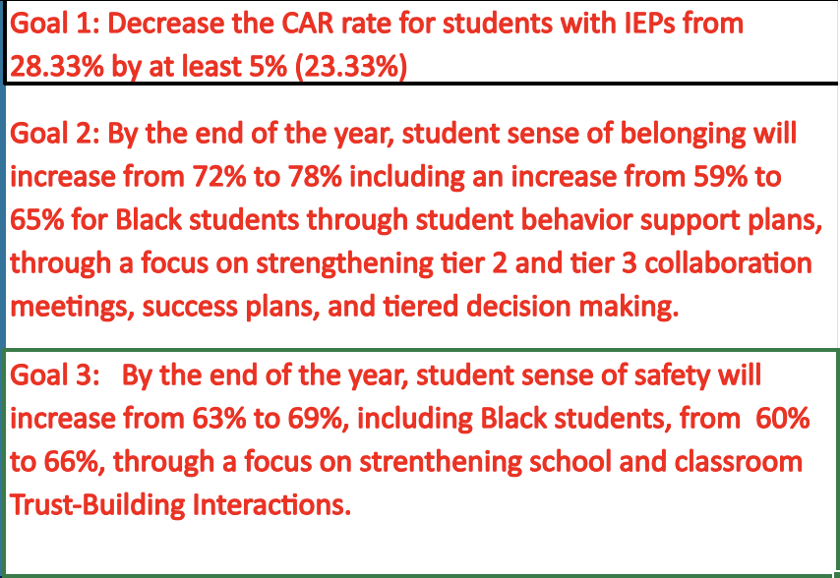
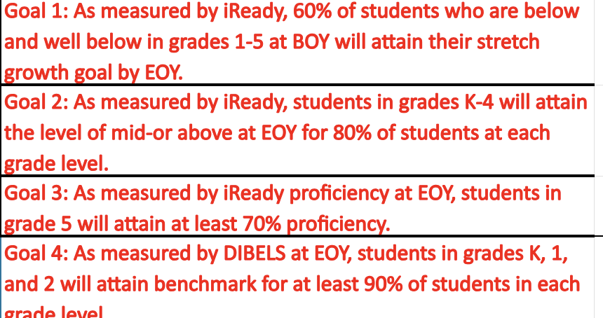
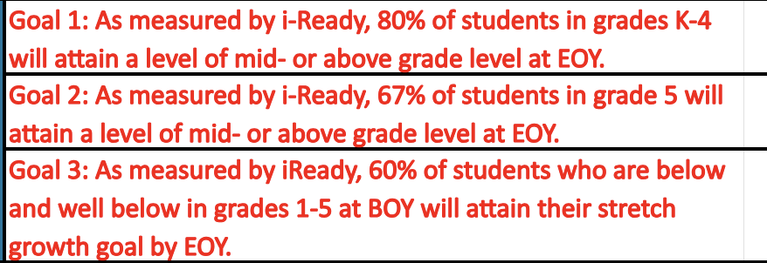
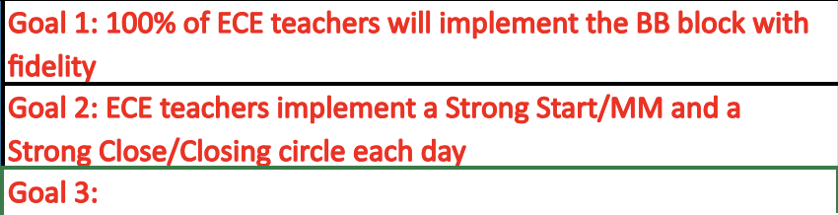
CSP Goals 25-26
Connected to Schools
Literacy
Math
Prepared for What's Next

Slide 9
LSAT Advisement

Slide 10
CSP 2024-2025 Review

Slide 11
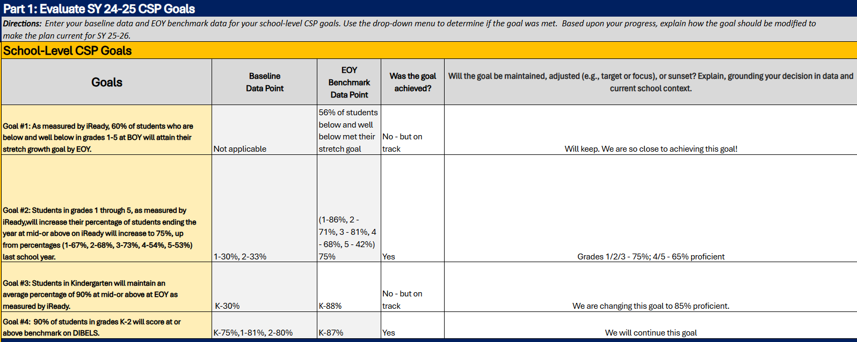

Literacy -Goal Evaluation
Screenshot the Goal Evaluation section from the CSP Eval below.

Slide 12
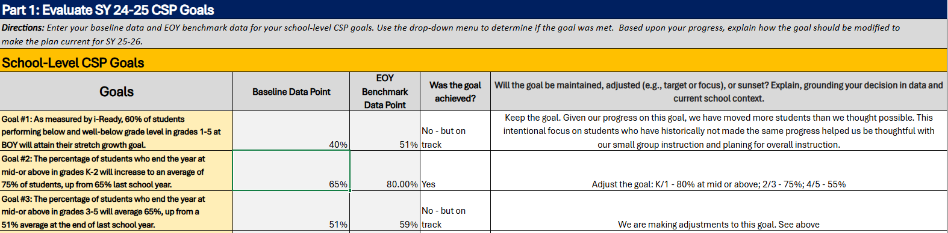
Mathematics-Goal Evaluation
Screenshot the Goal Evaluation section from the CSP Eval below.

Slide 13
Connected to Schools – Goal Evaluation
Part 1: Evaluate SY 24-25 CSP Goals
Directions: Enter your baseline data and EOY benchmark data for your school-level CSP goals. Use the drop-down menu to determine if the goal was met. Based upon your progress, explain how the goal should be modified to make the plan current for SY 25-26.
School-Level CSP Goals
Goals | Baseline Data Point | EOY Benchmark Data Point | Was the goal achieved? | Will the goal be maintained, adjusted (e.g., target or focus), or sunset? Explain, grounding your decision in data and current school context.
Goal #1: : 1) By EOY or the Spring Insight survey, we will increase the number of students in specialized education who feel a sense of belonging to at least 65%. This year, only 47% of SWD reportd they felt a sense of belonging. | 47% of SWD | 56% of SWD | No
Goal #2: When assessed through the Insight survey, all students will increase their sense of belonging from 72% from EOY 23-24 to 82% at EOY 24-25. | 68% | 76% | No - but on track
Goal #3:
Screenshot the Goal Evaluation section from the CSP Eval below.

Slide 14
LSAT Advisement

Slide 15
Special Education
4-FT inclusion teachers
1- .75 OT – provided by DCPS
0-SLP – provided by DCPS – an SLP came for 1 day to provide services for ECE students
1-FT SPED coordinator
3-FT self-contained teachers
5 out of 6-FT SPED aides
Staffing and programming
[waiting on data from missed hours for 24-25]

Slide 16
LSAT Advisement

Slide 17

Questions?

